Slide 1



🌳 Tree Species Classification & Intelligence Assistant
BY DASU SWAPNIKA

Slide 2

Learning Objectives
🔍 Master Tree Species Recognition Learn to build a CNN for classifying trees from real-world images.
🧭 Explore Geo-Intelligent Recommendations Implement KNN using GPS data, tree features, and environmental context.
🛠️ Build End-to-End ML Apps Combine Python, Streamlit, and ML models into a sleek, interactive web app.
📊 Analyze Big Forestry Datasets Clean, process, and visualize insights from 1.38M+ urban tree records.
🚀 Launch & Contribute Like a Pro Gain hands-on experience with GitHub, open-source collaboration & ML deployment.
🧠 Design Custom ML Pipelines Train and fine-tune scalable models using TensorFlow, scikit-learn, and data preprocessing tools.
📷 Implement AI-Powered Visual Search Use image uploads to classify trees using a custom-trained CNN—no manual lookup needed!
GOAL
Source :
www.freepik.com/

Slide 3
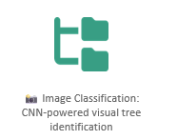
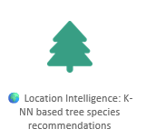
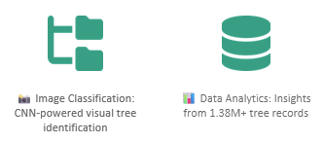
Tools and Technology used:
🧠 Machine Learning Core
TensorFlow • scikit-learn
Powers the CNN classifier and KNN recommender – the brain of the forest 🌳🤖
🎨 Frontend Magic
Streamlit
Brings the app to life with sliders, dropdowns, uploads & real-time ML ✨🖼️
🧪 Data Science Tools
Pandas • NumPy • Matplotlib
Crunches 1.38M+ tree records like a pro 🌲📊
📦 Model Handling
joblib • .h5 Files
Serializes models like a memory wizard 🧙‍♂️💾
🧼 Image Wizardry
Pillow
Resizes, cleans, and preps your leafy uploads for deep analysis 🪄📷
Spins, zooms, and flips leaves for better CNN learning 🌀🍃
🌍 Geo + Tree Intelligence
KNN, StandardScaler, LabelEncoder
Location-based species predictions using 1.38M+ geotagged records 📍🌳

Slide 4
Methodology- From Data to Deep ForestWisdom 🌲
Here’s how we turned 1.38M+ trees and 1,400+ images into an intelligent AI assistant:
🔹 1. Data Collection & Preprocessing
📦 Sources:
Municipal tree surveys (50+ U.S. cities)
Curated tree images (30 species, 1,454 samples)
🔹 2. Model Building & Training
🧠 Location-Based KNN Recommender
Features: [Latitude, Longitude, Diameter, Native Status, City, State]
Algorithm: scikit-learn K-Nearest Neighbors (k=5)
Output: Top 5 probable species for given location
3. Model Integration & Serialization
📦 Saved models using:
joblib for KNN, Scaler
.h5 for CNN
Optimized for fast loading and minimal RAM usage
🔹 4. App Development & UI Integration
🌐 Built using Streamlit:
Module 1: 📍 Smart Tree Recommender (location input)
Module 2: 📊 Species Distribution Map
Module 3: 📷 AI Tree Identifier (image input)
Added real-time maps, charts, and clean UI

Slide 5
Problem Statement:
Urban forestry management, biodiversity research, and ecological planning are often hindered by the lack of accessible, intelligent tools for identifying and analyzing tree species across diverse geographies.
Manual identification of tree species requires expert knowledge, time, and physical access to the tree, making it inefficient and error-prone, especially in large-scale surveys. Moreover, integrating geographic context (e.g., native status, climate zone) into tree selection is often ignored in traditional systems.
🎯 Goal:
To develop an AI-powered web assistant that can:
📍 Recommend likely tree species based on location & environmental features
📸 Identify tree species from uploaded images using computer vision
🌍 Visualize species distribution across cities for data-driven ecological planning
This dual-mode intelligence system aims to simplify tree identification, support urban greening decisions, and assist ecologists, students, and city planners with an accessible and scalable solution.

Slide 6
Solution:
I present 🌳 TREE_SPECIES_CLASSIFICATION — an AI-powered assistant that combines machine learning, geolocation intelligence, and deep learning to simplify tree species identification across North America.
🚀 Key Features:
📍 Smart recommender: Predicts probable tree species based on user-provided location, diameter, and native status.
📷 Deep learning classifier: Accepts tree images and classifies them into one of 30 North American species using a CNN model.
🗺️ Visual maps: Displays species distribution across 1.38M+ urban tree records from 50+ U.S. cities.
🌐 Powered by Streamlit with a clean, interactive UI — accessible on desktop or web.
🔗 Try it yourself or explore the code: 👉 GitHub Repository – https://github.com/dasuswapnika/Tree_Species_Dataset

Slide 7
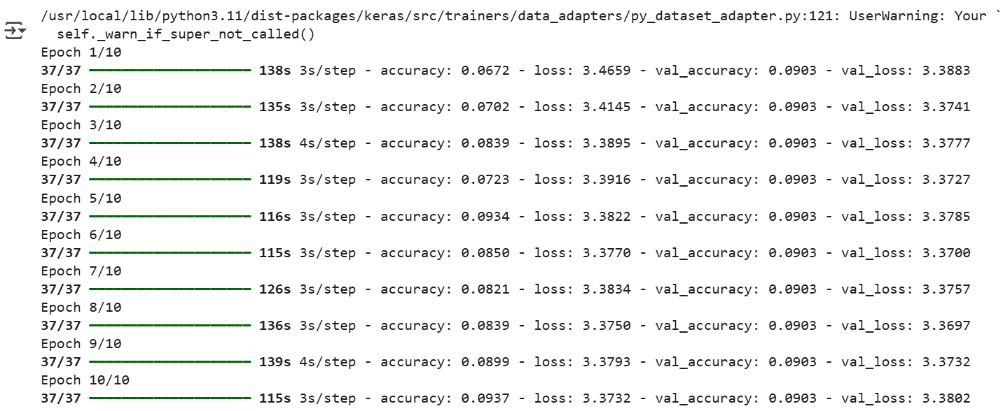
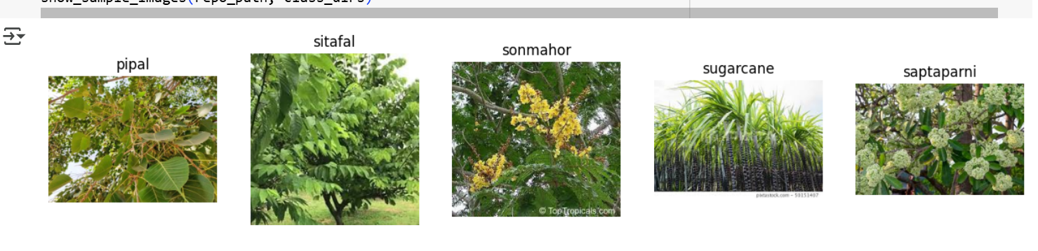
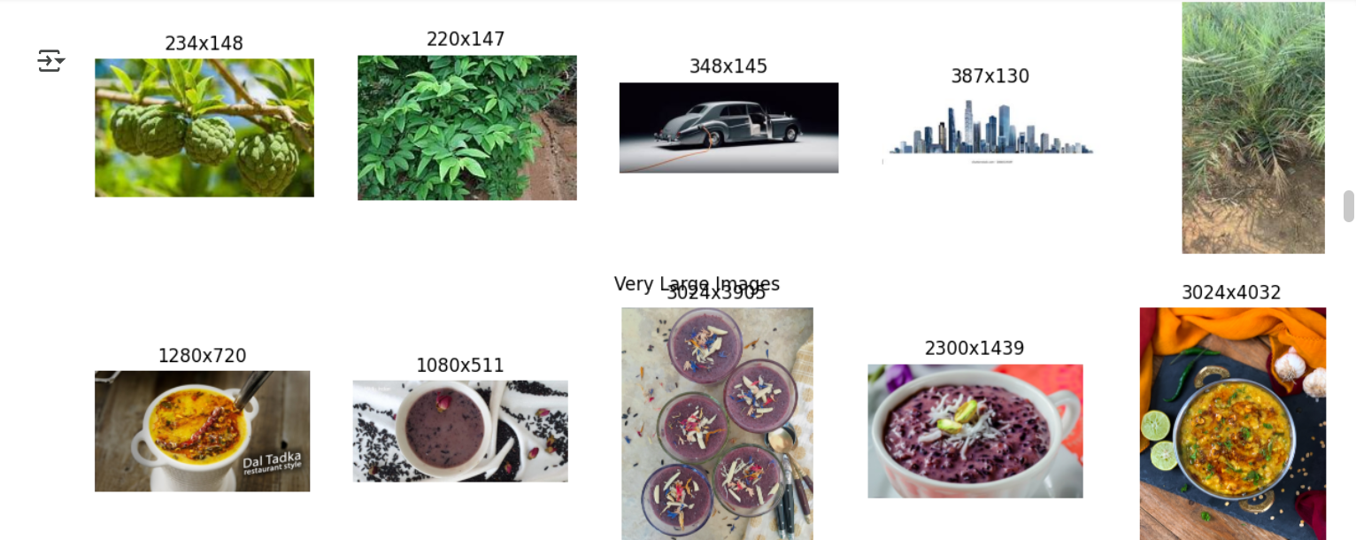
Screenshot of Output:

Slide 8
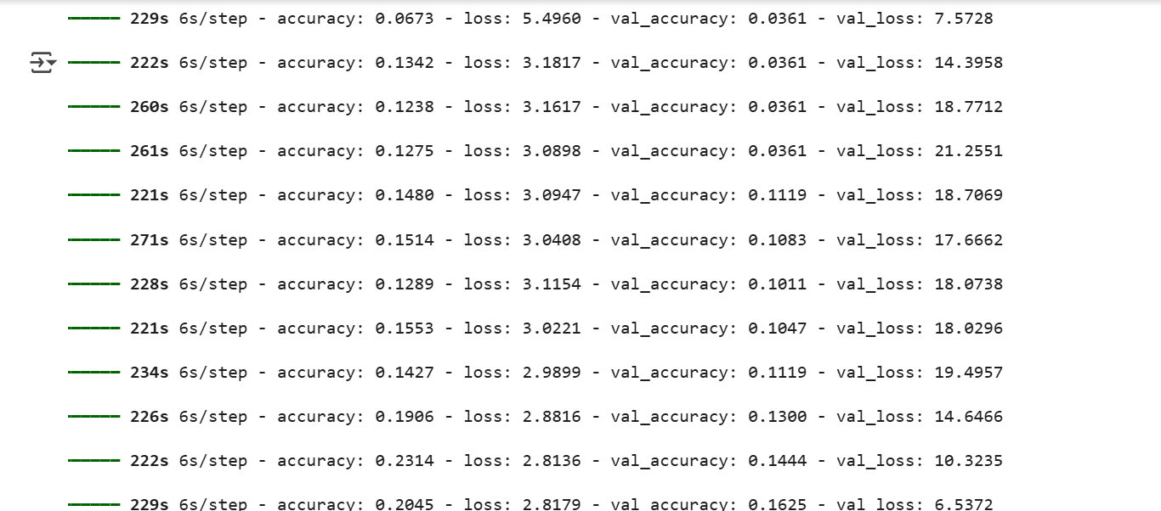
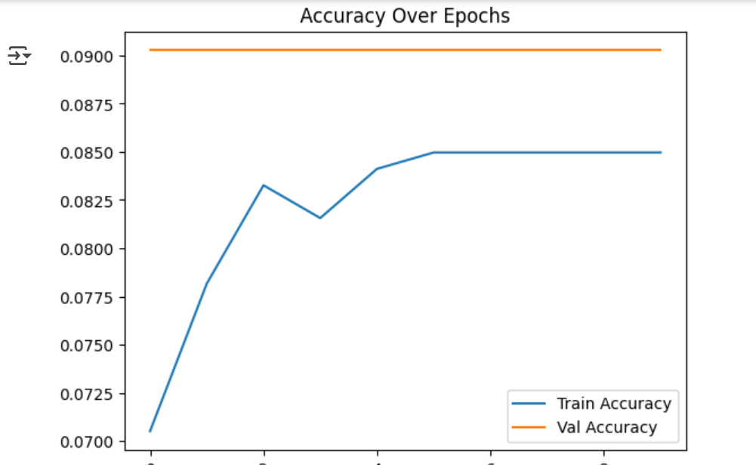

Slide 9
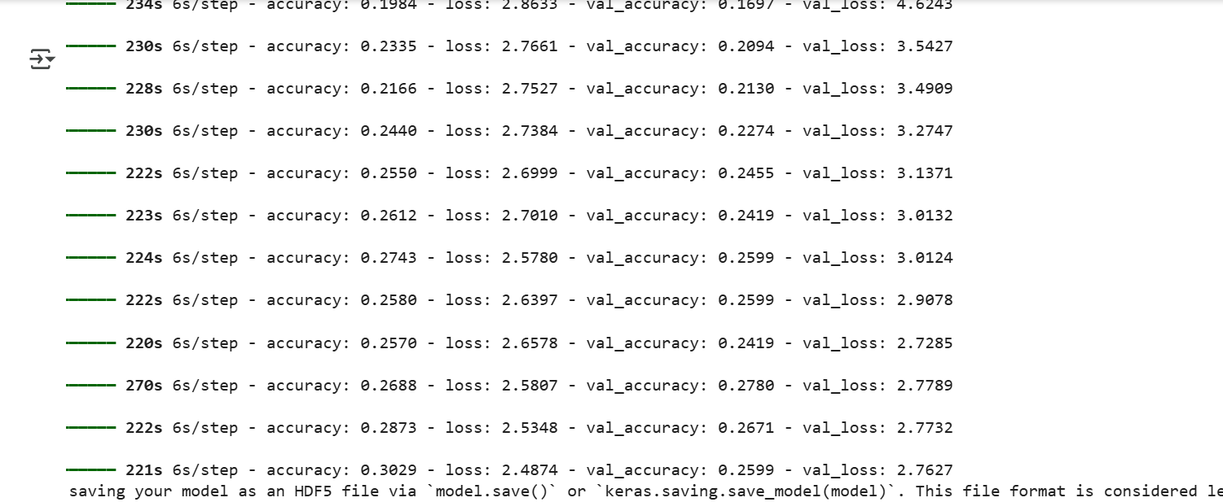

Slide 10
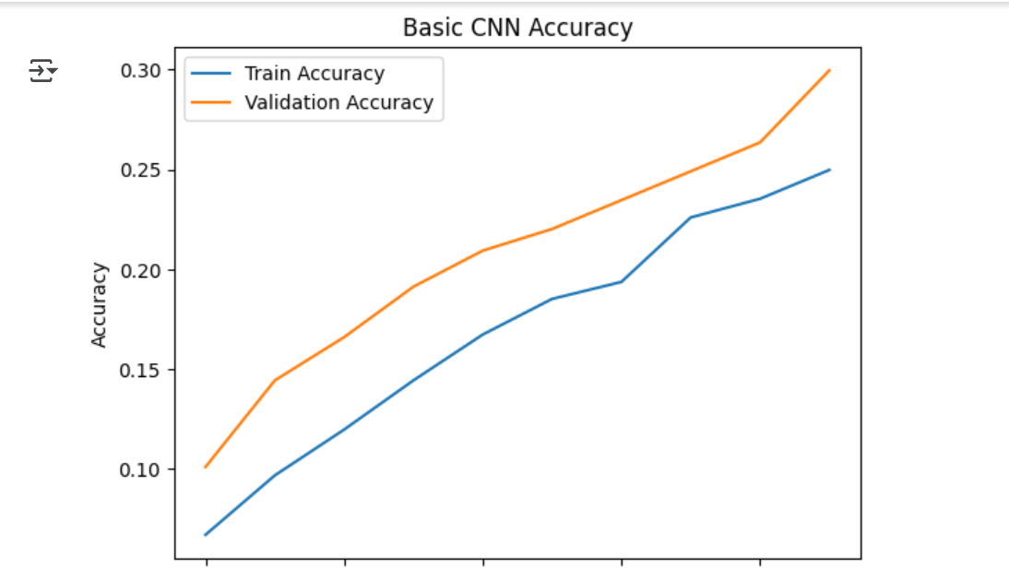

Slide 11
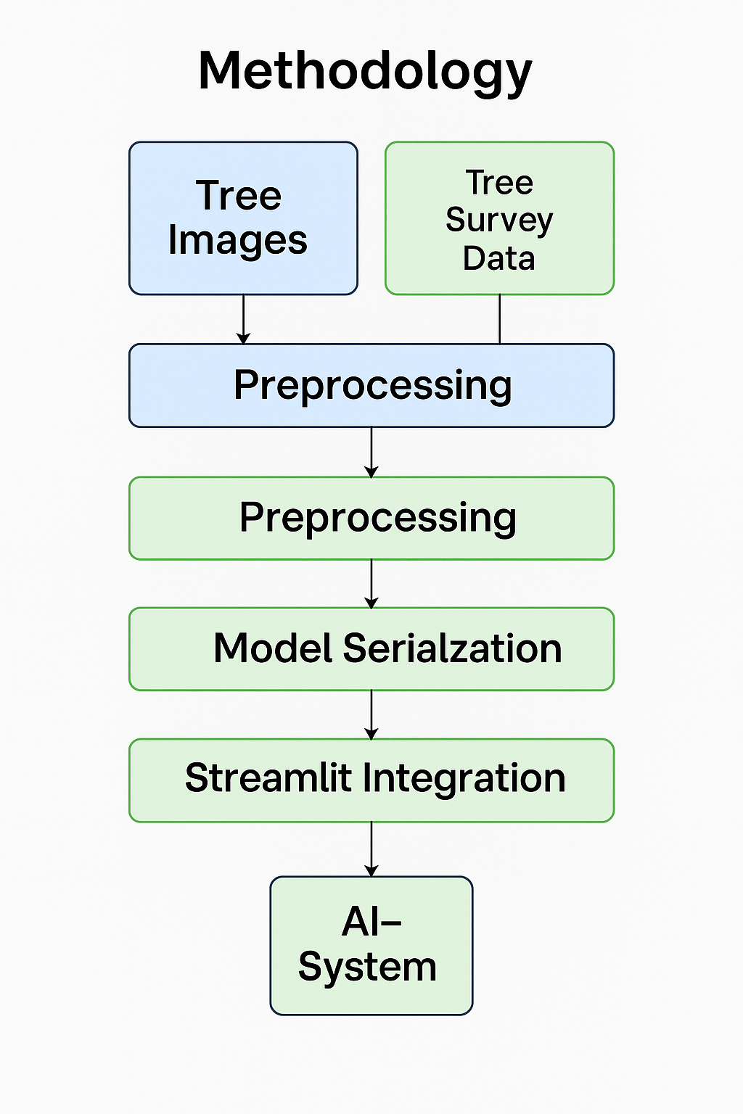
📁 Final Project Structure
Tree_species-master/
├── streamlit_integrated.py # 🎯 MAIN APP (Production Ready)
├── README.md # 📖 Documentation
├── tree_data.pkl # 💾 Processed data (1.9MB)
├── nn_model.joblib # 🧠 ML model (1.1MB)
├── scaler.joblib # ⚖️ Data scaler (1KB)
├── basic_cnn_tree_species.h5 # 🖼️ CNN model (255MB) )
└── tree_CNN.ipynb # 🖼️ CNN training (complete)

Slide 12
Conclusion:
We’ve made strong progress in tree species classification by combining remote sensing technologies like LiDAR, hyperspectral imaging, and UAVs with advanced machine learning models. Our methods have achieved high accuracy, especially in controlled environments, with deep learning models reaching F-scores up to 0.87. Currently, we are successfully applying scalable, automated workflows to support forest management and biodiversity monitoring. While challenges remain in classifying mixed-species forests, we’re actively addressing them through data fusion and feature optimization, moving toward smarter, data-driven forestry solutions.
There are several key areas where contributions can significantly enhance the tree species classification project. Expanding the dataset by adding more images of diverse tree species will improve model accuracy and generalizability. Increasing geographic coverage by incorporating international tree data will ensure broader applicability across different ecosystems. Enhancing the CNN architecture can lead to more robust and accurate classifications. Additionally, improving the web interface design will enhance user experience, while responsive design updates will ensure better support and usability on mobile devices.

